Slide 1
Minimum Hellinger Distance Estimation of Cox Proportional Hazard Model with Right Censored Data
Pengkun Liang
Department of Mathematics and Statistics
August 18, 2021

Slide 2
Contents
Motivation
Introduction
Proposed MHDEs for Cox PH model
Simulation studies
Real data analysis
Conclusion and future work

Slide 3
Motivation
MLE is sensitive to data contamination
How to reduce the influence of outlying/contaminated data in practice?
Kernel estimator based on the weight of each data point, Minimum Hellinger Distance Estimator (MHDE)
Application of MHDE in survival models

Slide 4
Introduction of Cox PH Model
Conditional hazard rate function given specified covariates
Several conditions should be met before we use Cox PH model:
1.Proportional hazards assumption;
2.Linearity in relationship between the log hazard and the continuous
covariates.

Slide 5
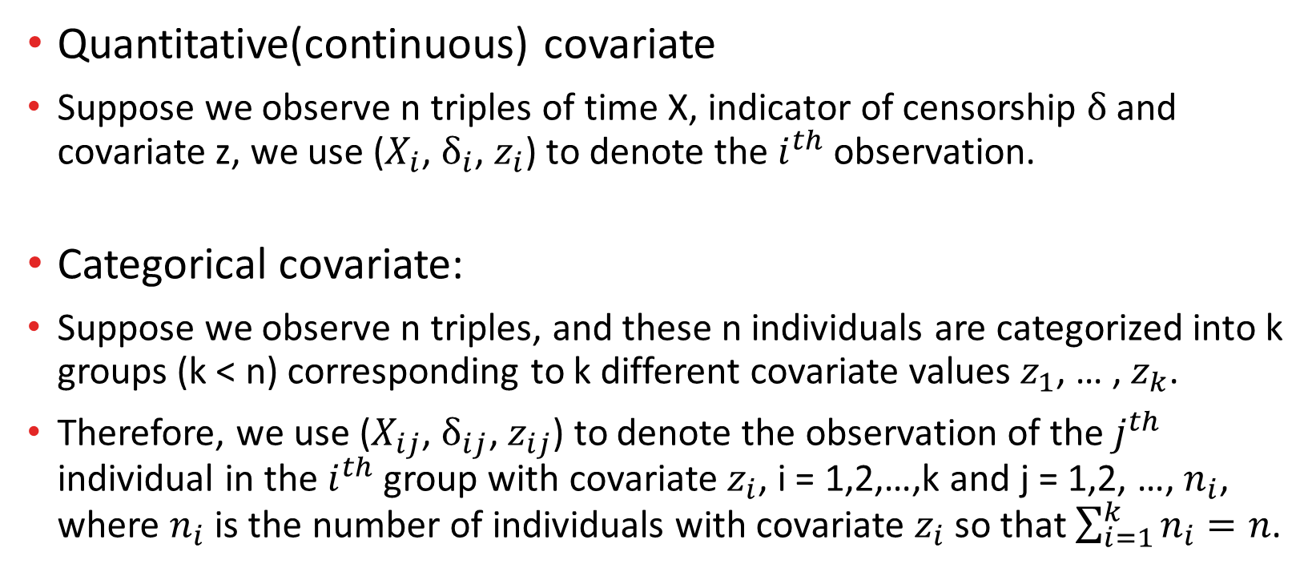
Covariates in Cox PH model
Quantitative(continuous) covariate
Suppose we observe n triples of time X, indicator of censorship $δ$ and covariate z, we use ($X_{i}$, $δ_{i}$, $z_{i}$) to denote the $i^{th}$ observation.
Categorical covariate:
Suppose we observe n triples, and these n individuals are categorized into k groups (k < n) corresponding to k different covariate values $z_{1}$, … , $z_{k}$.
Therefore, we use ($X_{ij}$, $δ_{ij}$, $z_{ij}$) to denote the observation of the $j^{th}$ individual in the $i^{th}$ group with covariate $z_{i}$, i = 1,2,…,k and j = 1,2, …, $n_{i}$, where $n_{i}$ is the number of individuals with covariate $z_{i}$so that $\sum_{i=1}^{k}{n_{i}}=n$.

Slide 6
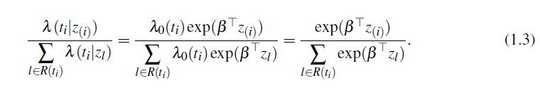

Introduction of PMLE
The conditional probability that, given the occurrence of the event at time $t_{i}$, it occurred on the individual with covariates $z_{(i)}$is given by

Slide 7


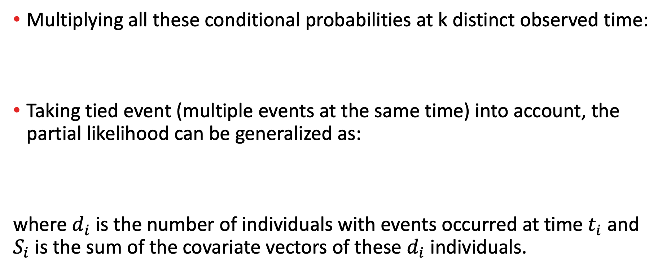
Introduction of PMLE
Multiplying all these conditional probabilities at k distinct observed time:
Taking tied event (multiple events at the same time) into account, the partial likelihood can be generalized as:
where $d_{i}$ is the number of individuals with events occurred at time $t_{i}$ and $S_{i}$ is the sum of the covariate vectors of these $d_{i}$ individuals.

Slide 8

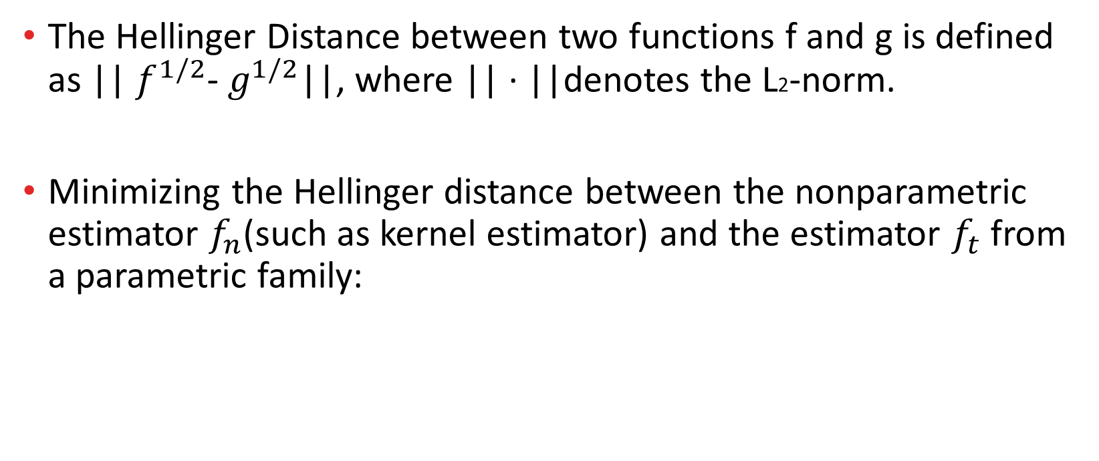
Introduction of MHDE
The Hellinger Distance between two functions f and g is defined as || $f^{1/2}$- $g^{1/2}$||, where || · ||denotes the L2-norm.
Minimizing the Hellinger distance between the nonparametric estimator $f_{n}$(such as kernel estimator) and the estimator $f_{t}$from a parametric family:

Slide 9

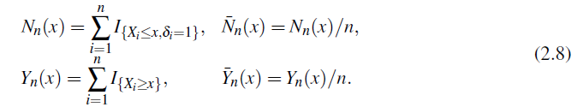

MHDE for survival models
Ying’s MHDE (1992):
Where:

Slide 10


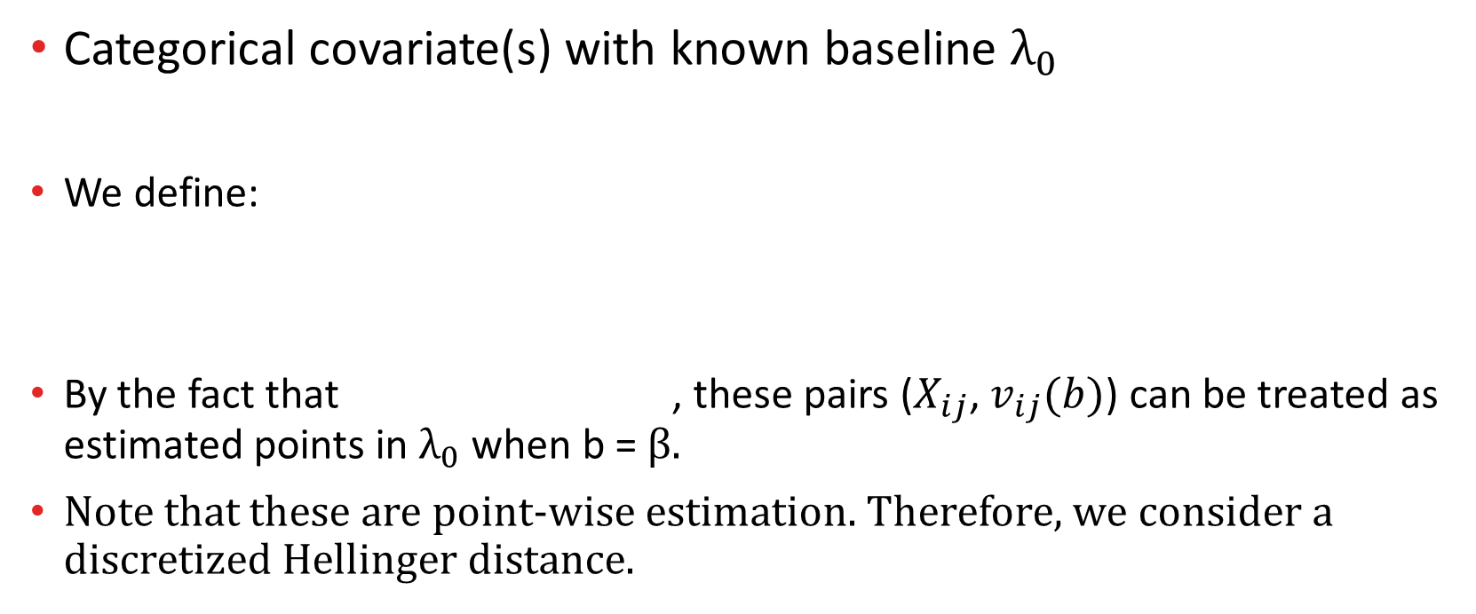
Proposed MHDE1 for Cox PH model
Categorical covariate(s) with known baseline ${\text{λ}}_{0}$
We define:
By the fact that , these pairs ($X_{ij}$, $v_{ij}(b)$) can be treated as estimated points in ${\text{λ}}_{0}$when b = β.
Note that these are point-wise estimation. Therefore, we consider a discretized Hellinger distance.

Slide 11


Proposed MHDE1 for Cox PH model
Follow the idea of minimum Hellinger distance, MHDE of β can be defined as the value in parametric space that minimizes the Hellinger distance between known ${\text{λ}}_{0}$and its parametric estimator:

Slide 12

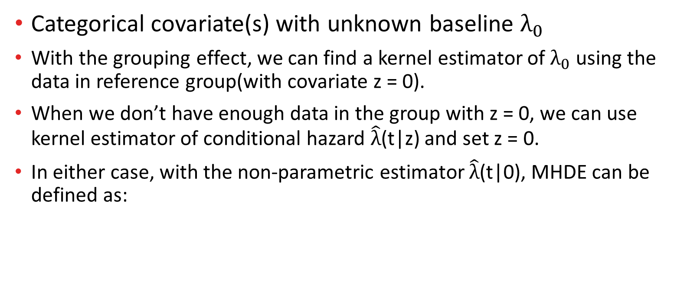
Proposed MHDE2 for Cox PH model
Categorical covariate(s) with unknown baseline ${\text{λ}}_{0}$
With the grouping effect, we can find a kernel estimator of ${\text{λ}}_{0}$using the data in reference group(with covariate z = 0).
When we don’t have enough data in the group with z = 0, we can use kernel estimator of conditional hazard $\hat{\text{λ}}$(t|z) and set z = 0.
In either case, with the non-parametric estimator $\hat{\text{λ}}$(t|0), MHDE can be defined as:

Slide 13


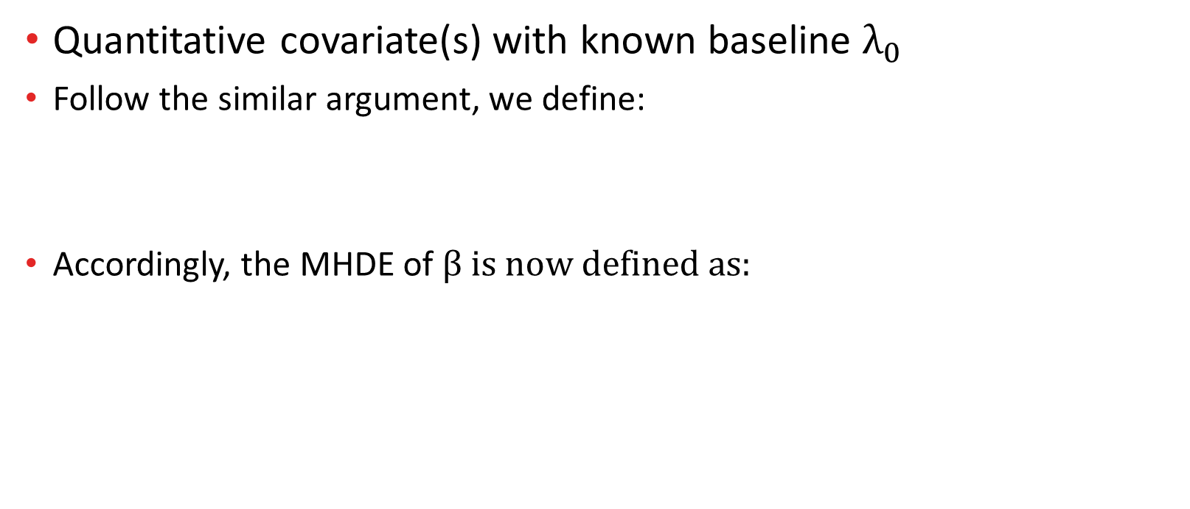
Proposed MHDE3 for Cox PH model
Quantitative covariate(s) with known baseline ${\text{λ}}_{0}$
Follow the similar argument, we define:
Accordingly, the MHDE of β is now defined as:

Slide 14

Proposed MHDE4 for Cox PH model
Quantitative covariate(s) with unknown baseline ${\text{λ}}_{0}$
Similarly, we can set z = 0 in the kernel estimator $\hat{\text{λ}}$(t|z) to derive a non-parametric estimator of baseline ${\text{λ}}_{0}$. Then MHDE in this case is defined as :

Slide 15


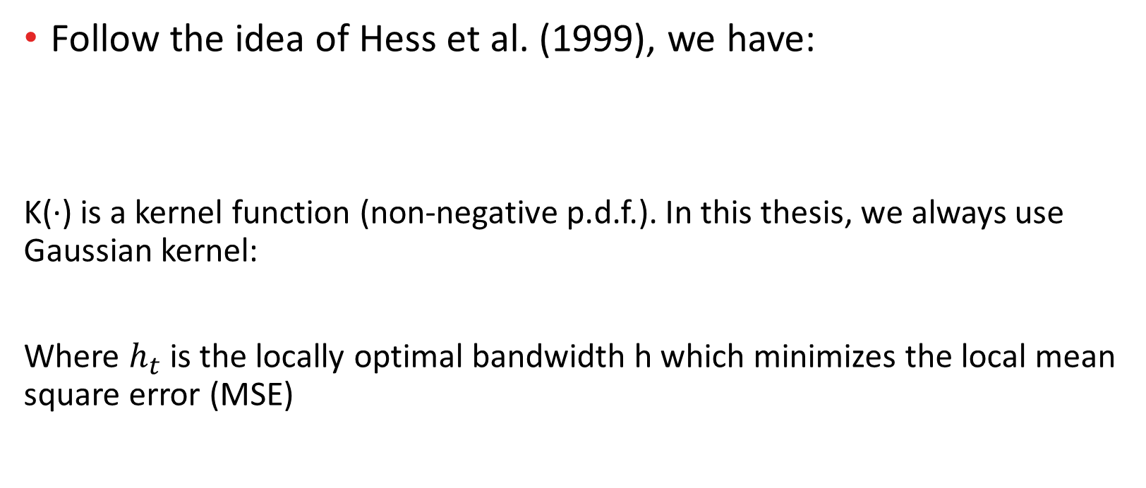
Kernel estimator of non-conditional hazard function
Follow the idea of Hess et al. (1999), we have:
K(·) is a kernel function (non-negative p.d.f.). In this thesis, we always use Gaussian kernel:
Where $h_{t}$ is the locally optimal bandwidth h which minimizes the local mean square error (MSE)

Slide 16



Kernel estimator of conditional hazard function
Follow the idea of Selingerov´a et al. (2014), we have:
Where the weight function is defined as:
K(·) is a kernel function, W(·) is the cumulative function of kernel K:

Slide 17
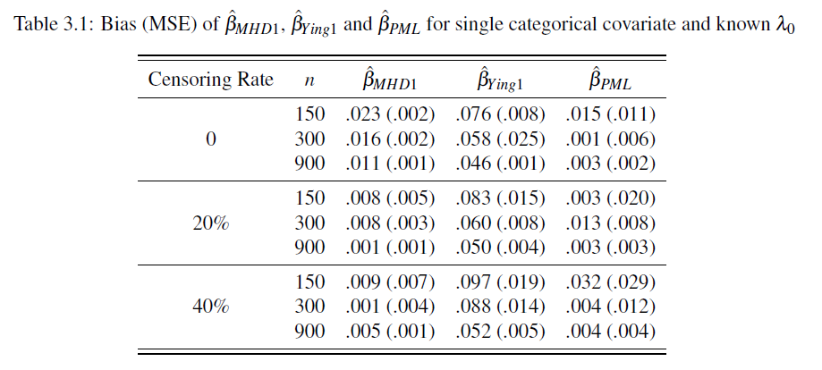

Simulation study (i): single categorical and known ${\text{λ}}_{0}$

Slide 18
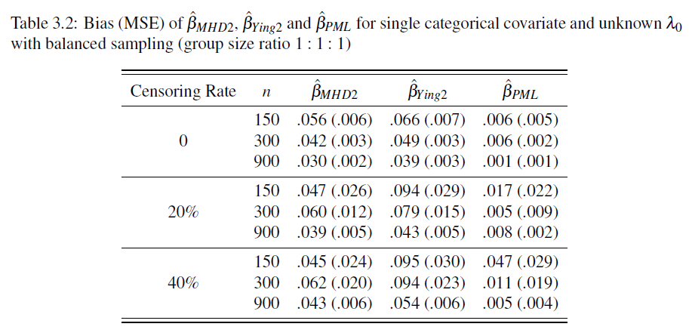

Simulation study (ii): single categorical and unknown ${\text{λ}}_{0}$

Slide 19
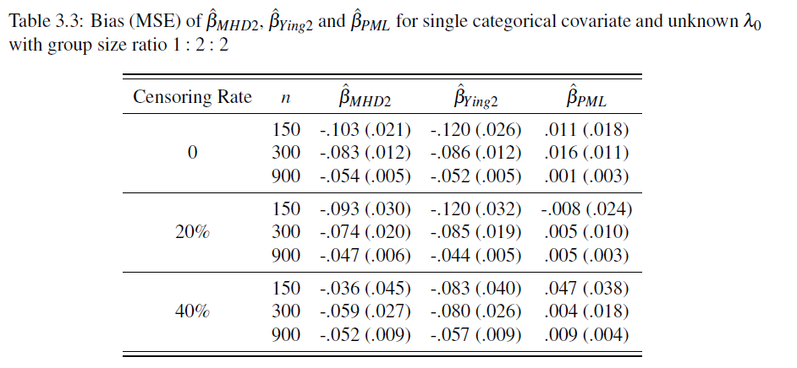

Simulation study (ii): single categorical and unknown ${\text{λ}}_{0}$

Slide 20
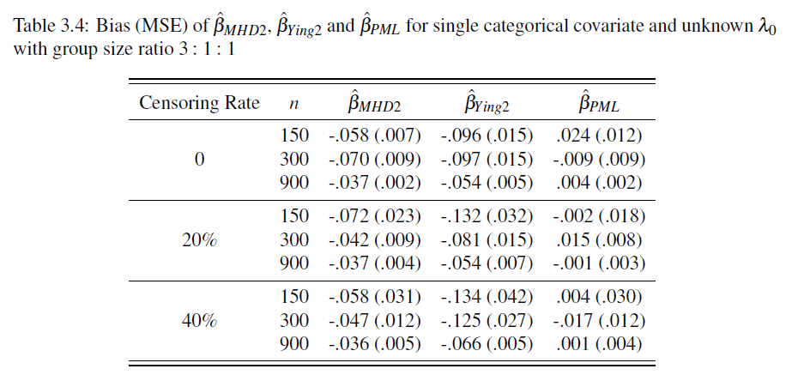

Simulation study (ii): single categorical and unknown ${\text{λ}}_{0}$

Slide 21
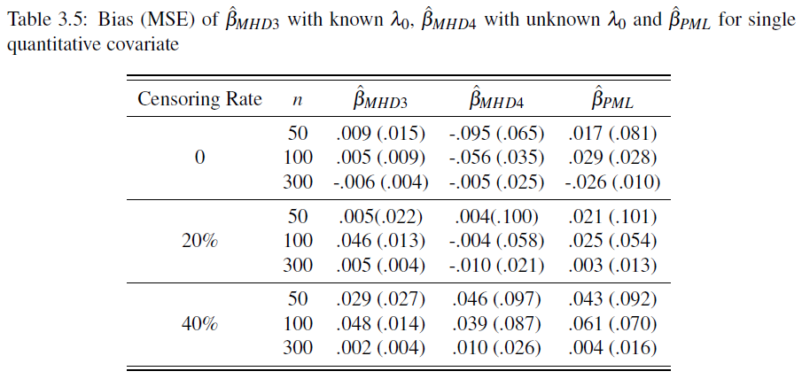
Simulation study (iii): Efficiency of single quantitative covariate

Slide 22
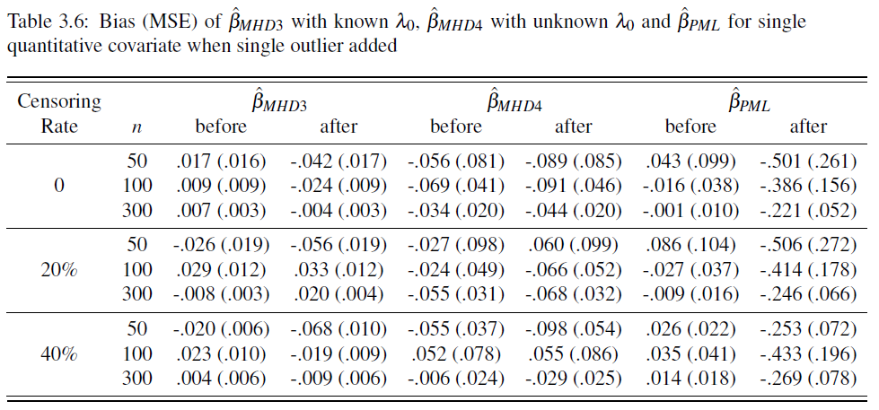
Simulation study (iV): Robustness of single quantitative covariate

Slide 23

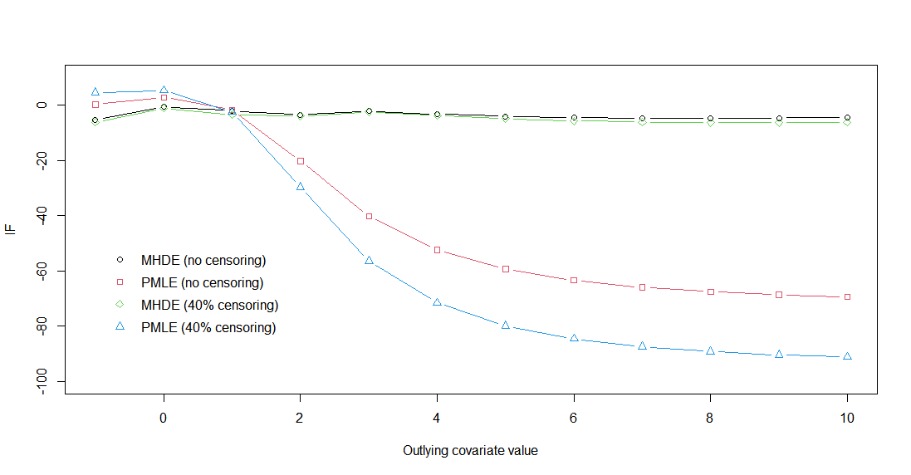
Simulation study (V): Influence of the outlying covariate value

Slide 24
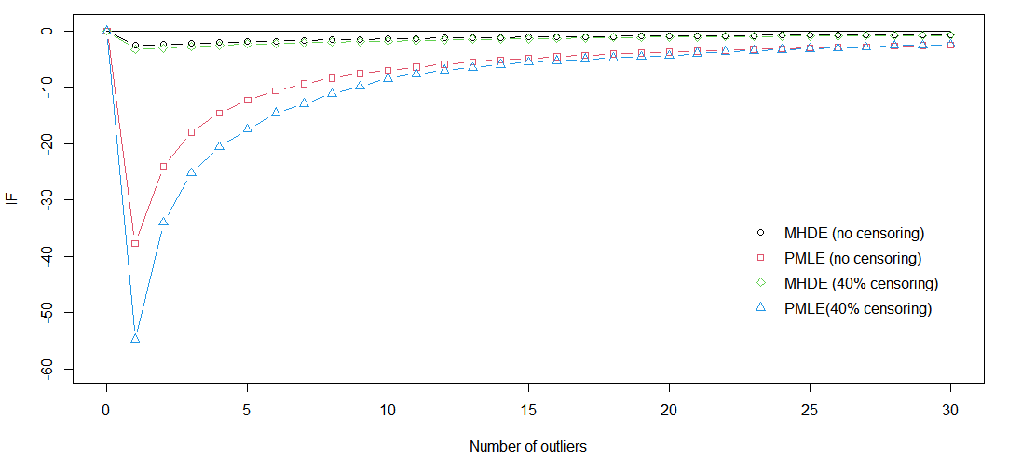
Simulation study (Vi): Influence of the number of outliers

Slide 25
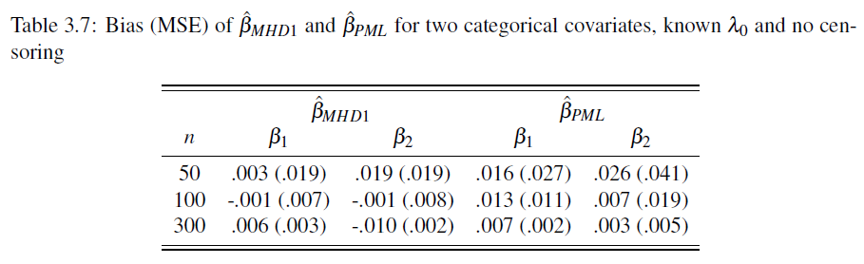

Simulation study (Vii): Efficiency of two categorical covariates and known ${\text{λ}}_{0}$

Slide 26
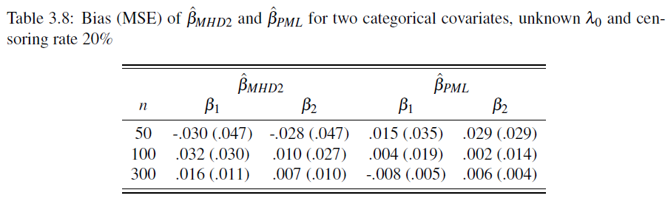

Simulation study (Vii): Efficiency of two categorical covariates and unknown ${\text{λ}}_{0}$

Slide 27
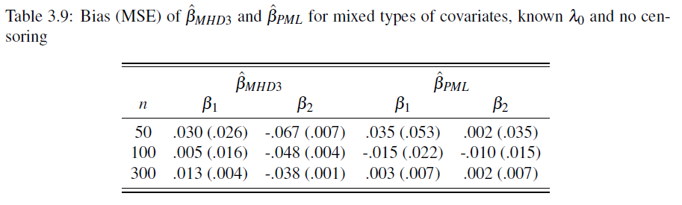

Simulation study (Viii): Efficiency of mixed types of covariates and known ${\text{λ}}_{0}$

Slide 28
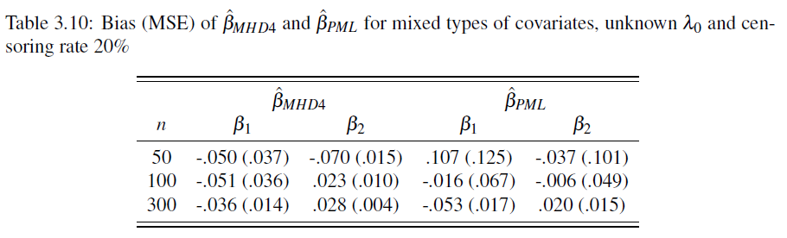

Simulation study (Viii): Efficiency of mixed types of covariates and unknown ${\text{λ}}_{0}$

Slide 29
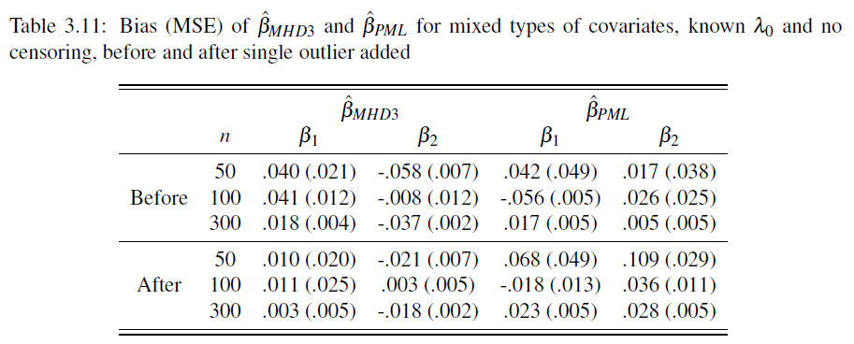

Simulation study (iX): Robustness of mixed types of covariates and known ${\text{λ}}_{0}$

Slide 30
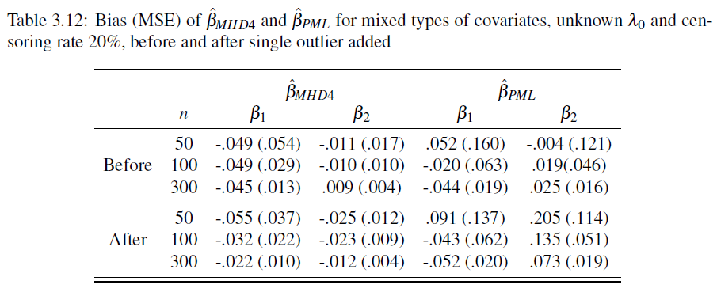

Simulation study (iX): Robustness of mixed types of covariates and unknown ${\text{λ}}_{0}$

Slide 31
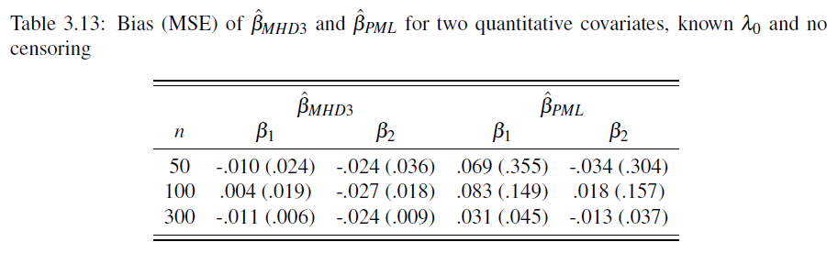

Simulation study (X): Efficiency of two quantitative covariates and known ${\text{λ}}_{0}$

Slide 32
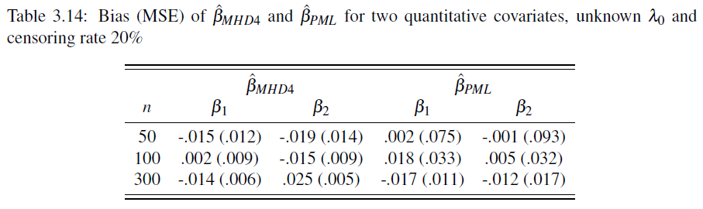

Simulation study (X): Efficiency of two quantitative covariates and unknown ${\text{λ}}_{0}$

Slide 33
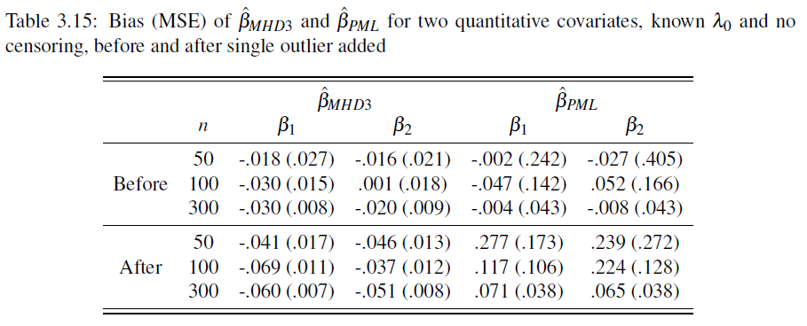

Simulation study (Xi): Robustness of two quantitative covariates and known ${\text{λ}}_{0}$

Slide 34
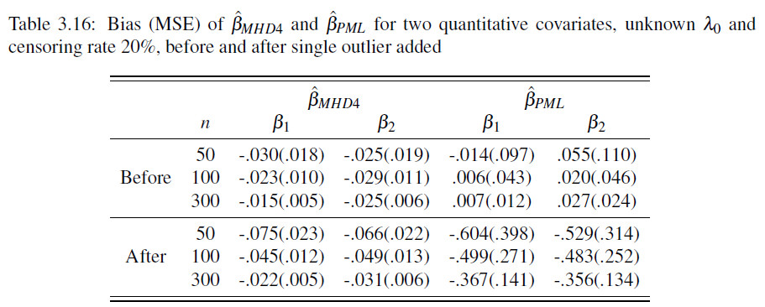

Simulation study (Xi): Robustness of two quantitative covariates and unknown ${\text{λ}}_{0}$

Slide 35

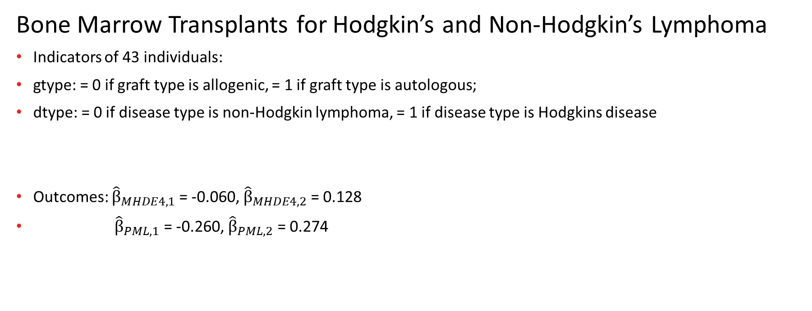
Real data analysis (i)
Bone Marrow Transplants for Hodgkin’s and Non-Hodgkin’s Lymphoma
Indicators of 43 individuals:
gtype: = 0 if graft type is allogenic, = 1 if graft type is autologous;
dtype: = 0 if disease type is non-Hodgkin lymphoma, = 1 if disease type is Hodgkins disease
Outcomes: ${\hat{\text{β}}}_{MHDE4,1}$ = -0.060, ${\hat{\text{β}}}_{MHDE4,2}$ = 0.128
${\hat{\text{β}}}_{PML,1}$ = -0.260, ${\hat{\text{β}}}_{PML,2}$ = 0.274

Slide 36

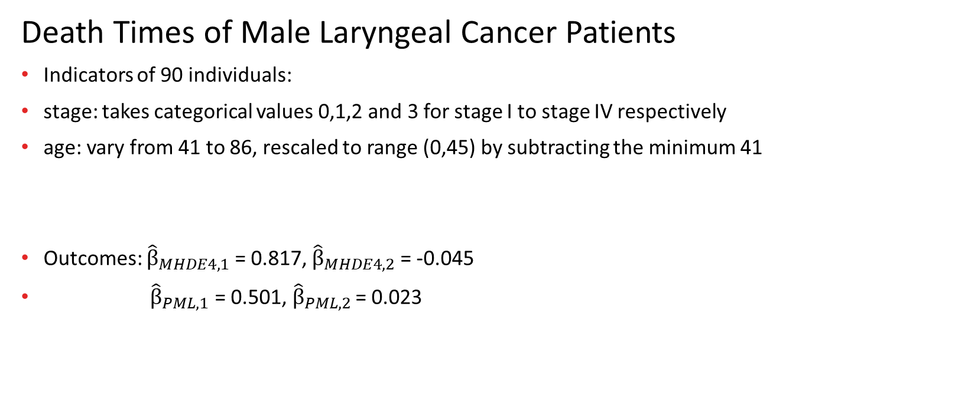
Real data analysis (ii)
Death Times of Male Laryngeal Cancer Patients
Indicators of 90 individuals:
stage: takes categorical values 0,1,2 and 3 for stage I to stage IV respectively
age: vary from 41 to 86, rescaled to range (0,45) by subtracting the minimum 41
Outcomes: ${\hat{\text{β}}}_{MHDE4,1}$ = 0.817, ${\hat{\text{β}}}_{MHDE4,2}$ = -0.045
${\hat{\text{β}}}_{PML,1}$ = 0.501, ${\hat{\text{β}}}_{PML,2 }$= 0.023

Slide 37
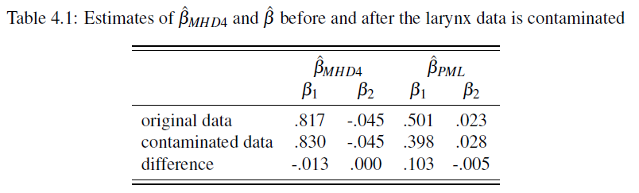
Real data analysis (ii)
Death Times of Male Laryngeal Cancer Patients
We notice that the No. 83 patient has a reference age 0 and a relatively short survival time 1.0. We deliberately replace the age of this patient by 24, which is the median age of patients in this dataset. We also replace the survival time of this patient by 15, which is larger than the sample maximum value 10.7. Consequently No. 83 patient can be regarded as an outlying observation.

Slide 38
Conclusion
When the model assumption is valid without outliers, our MHDEs are competitive with PMLE in terms of bias and MSE, regardless of covariate type.
Our MHDEs are much more robust than PMLE against single outlier and contaminating data with multiple outliers.

Slide 39
Future work
Theoretical examination (like consistency and asymptotic normality) of the MHDEs need to be done in our future work.
We may construct MHDE for more general or more complicated models other than Cox model, e.g. accelerated failure time (AFT) model and cure rate model.

Slide 40
Reference
D. R. Cox. Regression models and life-tables. Journal of the Royal Statistical Society: Series B (Methodological), 34(2):187–202, 1972.
D. R. Cox. Partial likelihood. Biometrika, 62(2):269–276, 1975.
I. Selingerov´a, I. Horov´a, and J. Zelinka. Kernel estimation of conditional hazard function for cancer data. 2014.
K. R. Hess, D. M. Serachitopol, and B.W. Brown. Hazard function estimators: a simulation study. Statistics in medicine, 18(22):3075–3088, 1999.
Z. Ying. Minimum hellinger-type distance estimation for censored data. The Annals of Statistics, pages 1361–1390, 1992.
https://www.rdocumentation.org/packages/KMsurv/versions/0.1-5/topics/hodg.
https://www.rdocumentation.org/packages/KMsurv/versions/0.1-5/topics/larynx.

Slide 41
Thank you !
Pengkun Liang
August 18, 2021

